Slide 1
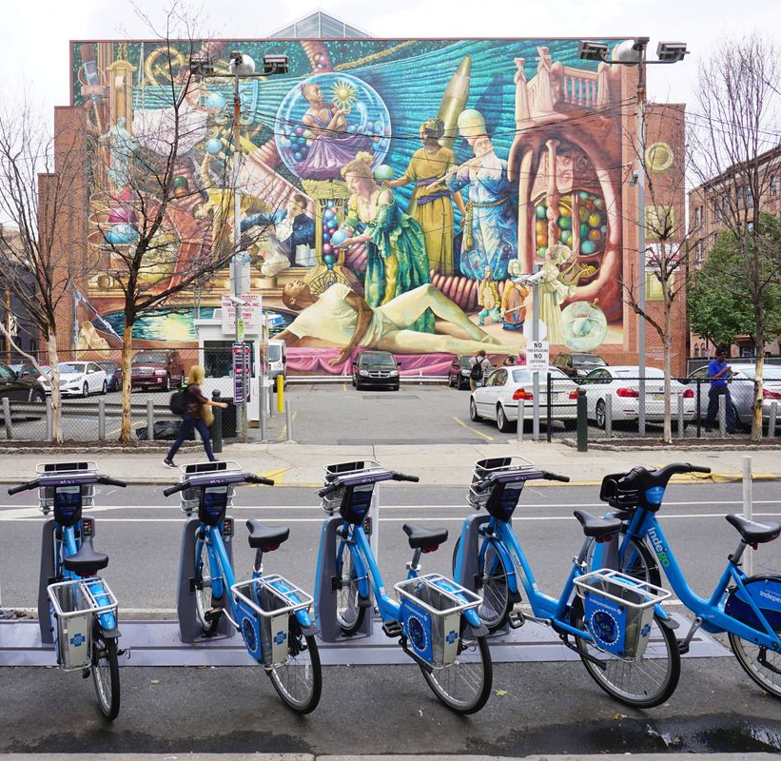
Improvements To Worker Assignment Problem
Trent Johnson
Georgia Institute of Technology
Department of Mathematics
Jie Wu
Temple University
Department of Information and Computer Sciences

Slide 2
Table of Contents
What is Bike Sharing
Rebalancing Problem
Ways to solve Bike Rebalancing
Worker Assignment Problem
Algorithms for Worker Assignment Problem
Comparison of Algorithms
Summary

Slide 3
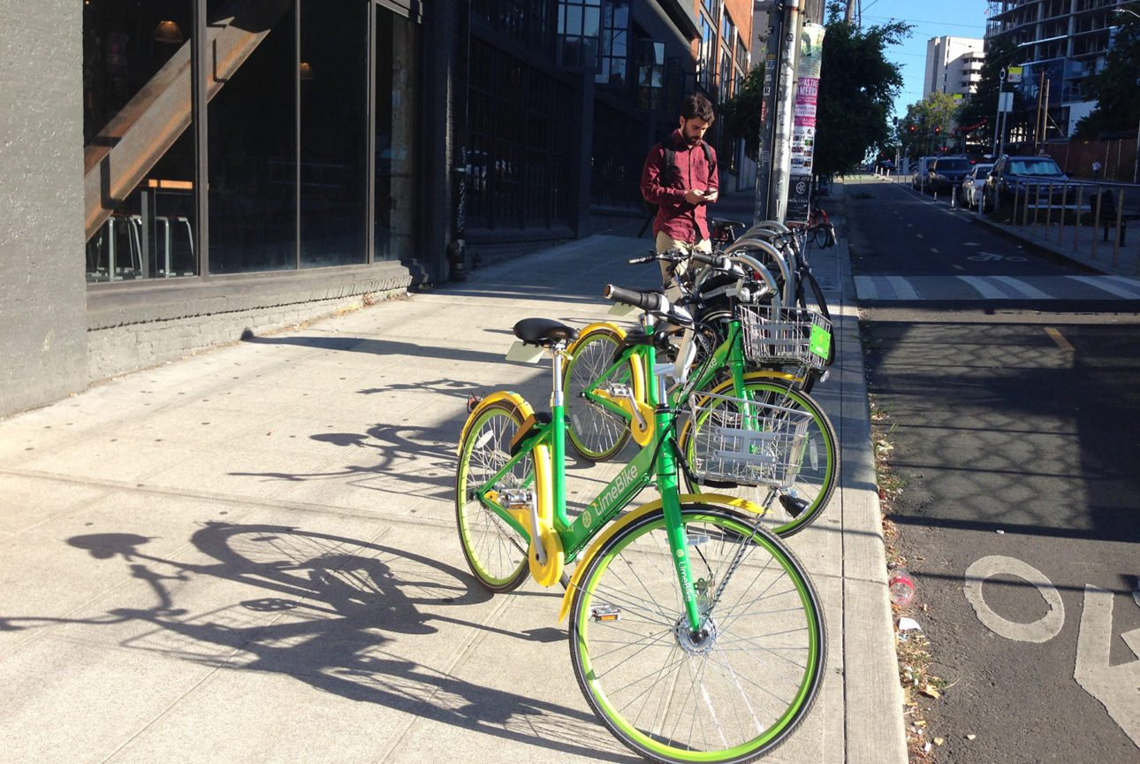
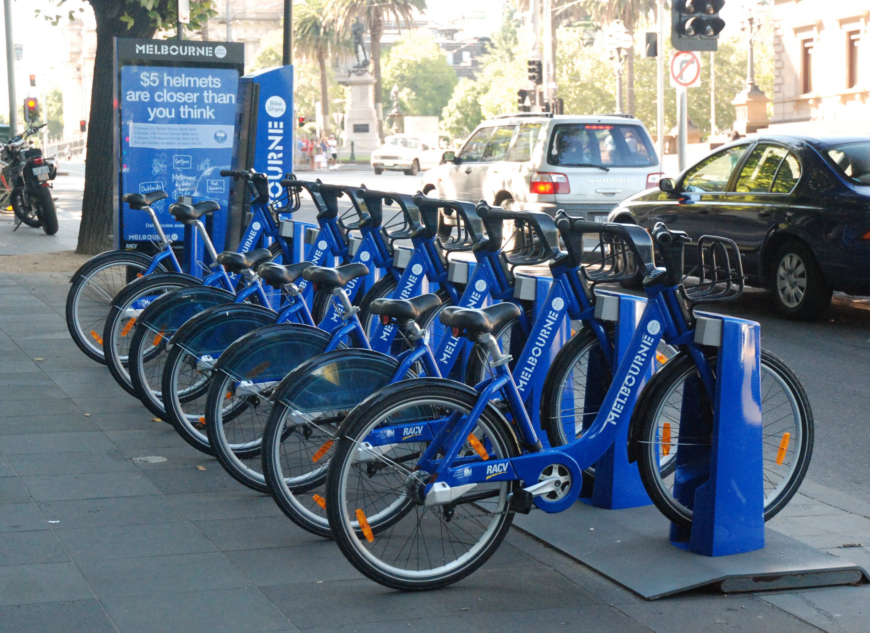
What is a Bike Sharing System
Bike Sharing Systems (BSSs)
Docked vs Dockless
Benefits
Exercise
Eco-Friendly
Reduce Traffic
Cheap
Low Infrastructure Public Transportation
Alta Planning + Design. LimeBike in Seattle, Washington. Seattle
K, P. (n.d.). Melbourne City Bikes. photograph, Melbourne.

Slide 4
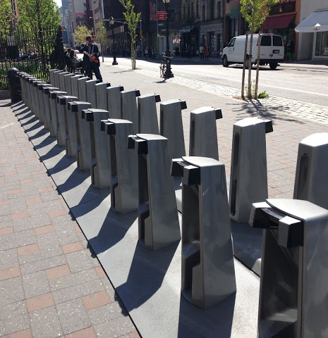
What is Rebalancing?
Demands for stations change with location and time
Overflow/Underflow station- stations with too many or not enough bikes
Gwenneth Leech. Empty bike docking station at Spring and Lafayette. New York City

Slide 5
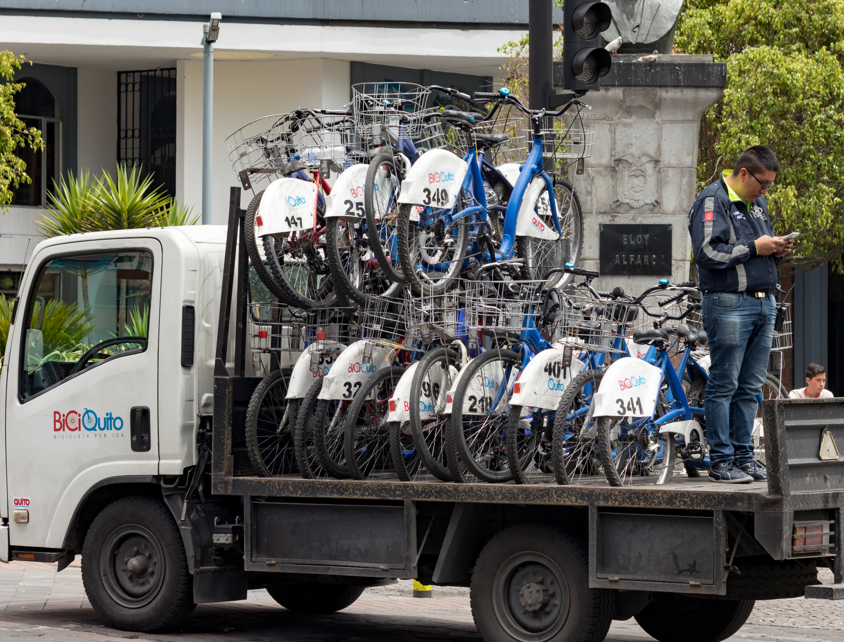
Trucks for Rebalancing
Optimal Hamiltonian Path
Traveling Salesman
Advantages
Centralized
Controlled
Disadvantages
Expensive
Cause Traffic
Pollution
Ted Timmons. BiciQuito bikeshare rebalancing truck. Quito

Slide 6
Crowdsourcing with Users
Use existing users to rebalance stations
Incentive Model
Have “prices” for stations that need rebalancing
Any user can rebalance for the reward to a station of their choice
Assignment Model
Hire workers to rebalance whenever they use the BSS
Assign workers station rebalace

Slide 7
Spatial vs Temporal
Rebalancing can be divided into separate spatial and temporal problems
Temporal
Divide the day into time slices
Predict workers and station demands in the time slice
Spatial
Create incentives/assignments based on predictions

Slide 8
Worker Assignment Problem
Same number of workers, overflow targets, and underflow targets
Create optimal assignment of worker to go

Slide 9
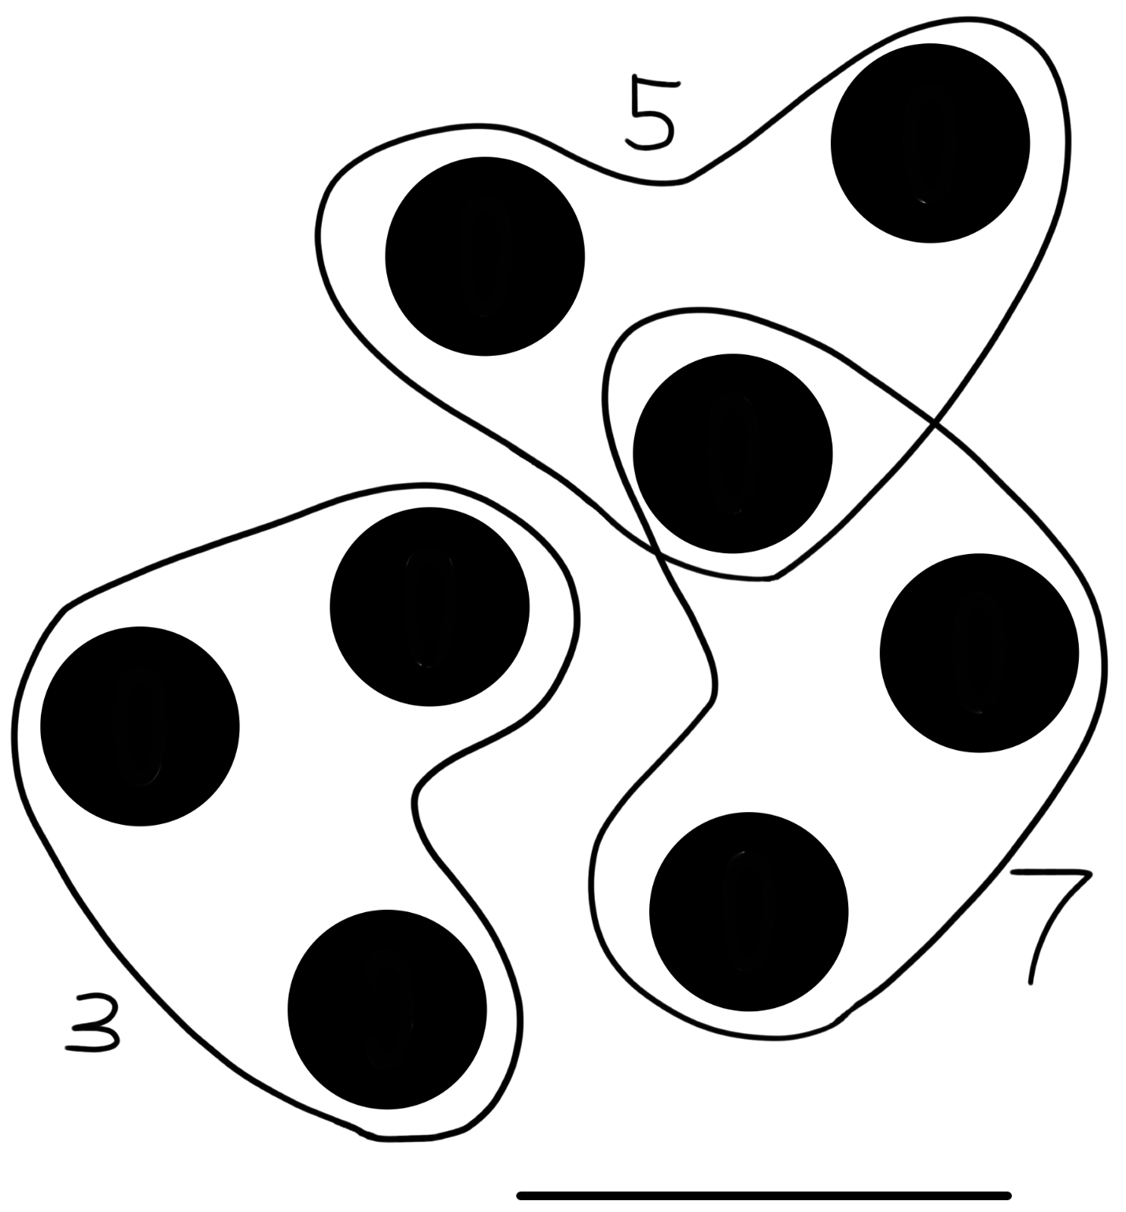
3-Dimensional Matching
Graph Matching- Find a collection of disjoint edges in a graph with maximal weight
Polynomial Time with Hungarian Method
3D Hypergraph- Graph with edges that connect three vertices rather than two
3-Dimensional Matching- Find collection of disjoint edges in a graph with maximal weight
NP-Hard

Slide 10
Algorithms

Slide 11
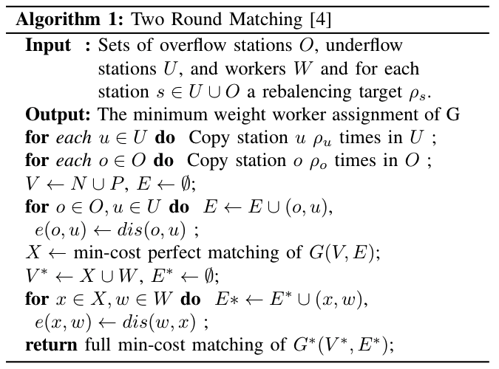
Two Round Matching (TRM)
Create overflow/underflow matching
Create worker/station pair matching

Slide 12
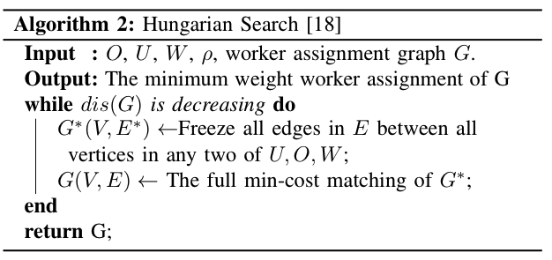
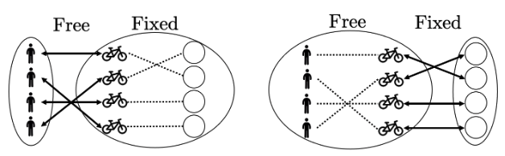
Hungarian Search (HS)
Iteratively fix sections of the graph
Perform a matching on the constrained graph
Genetic Hungarian Search
Performa a genetic algorithm to find best graph
HS on each generation

Slide 13
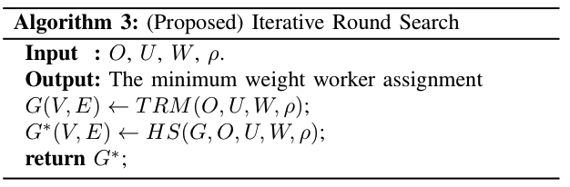
Initialized Hungarians Search (Proposed)
Make an approximate graph with TRM
Run HS on the graph

Slide 14
Results

Slide 15
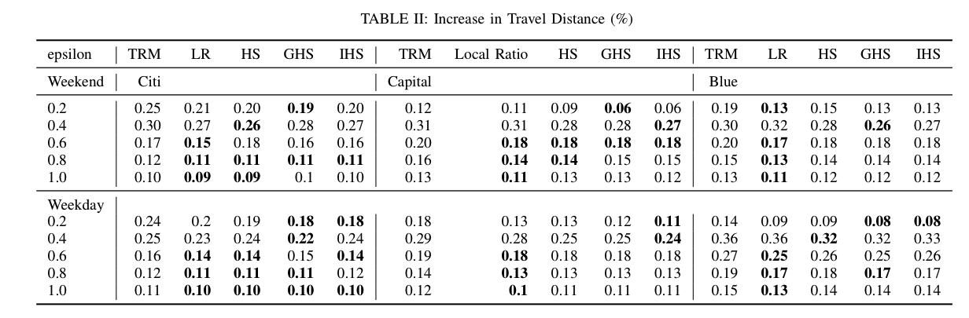
Detour Distance

Slide 16
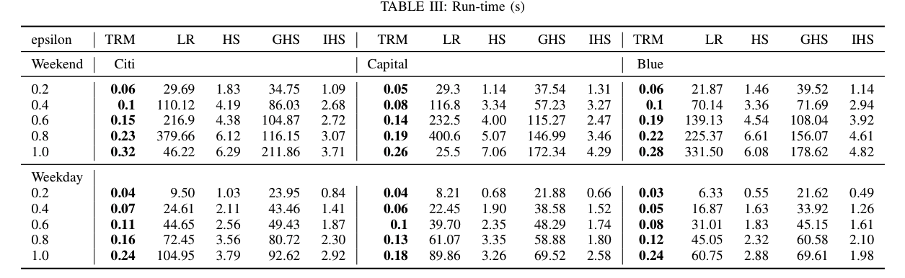
Runtime

Slide 17
Conclusion
Similar performance at reduced runtimes
Better suited for real time applications
Can be adapted to help inform incentive models for more personalized incentives

